Slide 1


Commissioning
Air Force ROTC Detachment 842
The University of Texas at San Antonio
C/2d Lt Frankie Rodriguez & C/1st Lt Joanna Finley
08 May 23

Slide 2


Overview
Series of events
Venue Information
Save The Date
Script
Volunteers?
Summary
Air Force ROTC Detachment 842 • We Build Exceptional Officers • The University of Texas at San Antonio

Slide 3
Series of Events

Slide 4
Series of Events 11th
1500-1600: set up chairs
DEPART IAAFA
0830 C/Rodriguez & C/Finley arrive
0900: Cadet Volunteers SHOWTIME
0900-0930: Set up IAAFAs chairs
0930-1130: Set up stage
1130-1230: LUNCH
1230-1430: Commissionee Practice
14:45: Pick up Chairs from ODR
Air Force ROTC Detachment 842 • We Build Exceptional Officers • The University of Texas at San Antonio

Slide 5
Series of Events 12th
1125-1225- Cadets go up and Pin on 2d LT with first salute
1225-1230 Closing remarks from Lt. Col Hoffman
1230 Air Force Song
1240-1400 Individual Oaths of Office
SIMULTANEOUSLY HAPPENING
1240-1400 Cake and refreshments
1400 End of event
0945 SHOWTIME
1015-1050 Q&A w/ Maj. Gen Stewart
Guest showtime 1030-1045
1100: Ceremony starts
1105-1110: the arrival of the official party with cadets marching in
1110-1115: Posting of the colors and national anthem and invocation
1115-1125- Opening Remarks by Lt Gen Robinson
MASS OATH IS GIVEN
Air Force ROTC Detachment 842 • We Build Exceptional Officers • The University of Texas at San Antonio

Slide 6
UOD

Slide 7
UOD
POC
Full Service Dress
GMC
Service Dress (IF YOU HAVE IT)
Open Collar Blues
Business Casual
Thursday set up
Civies
Air Force ROTC Detachment 842 • We Build Exceptional Officers • The University of Texas at San Antonio

Slide 8
Venue Information

Slide 9
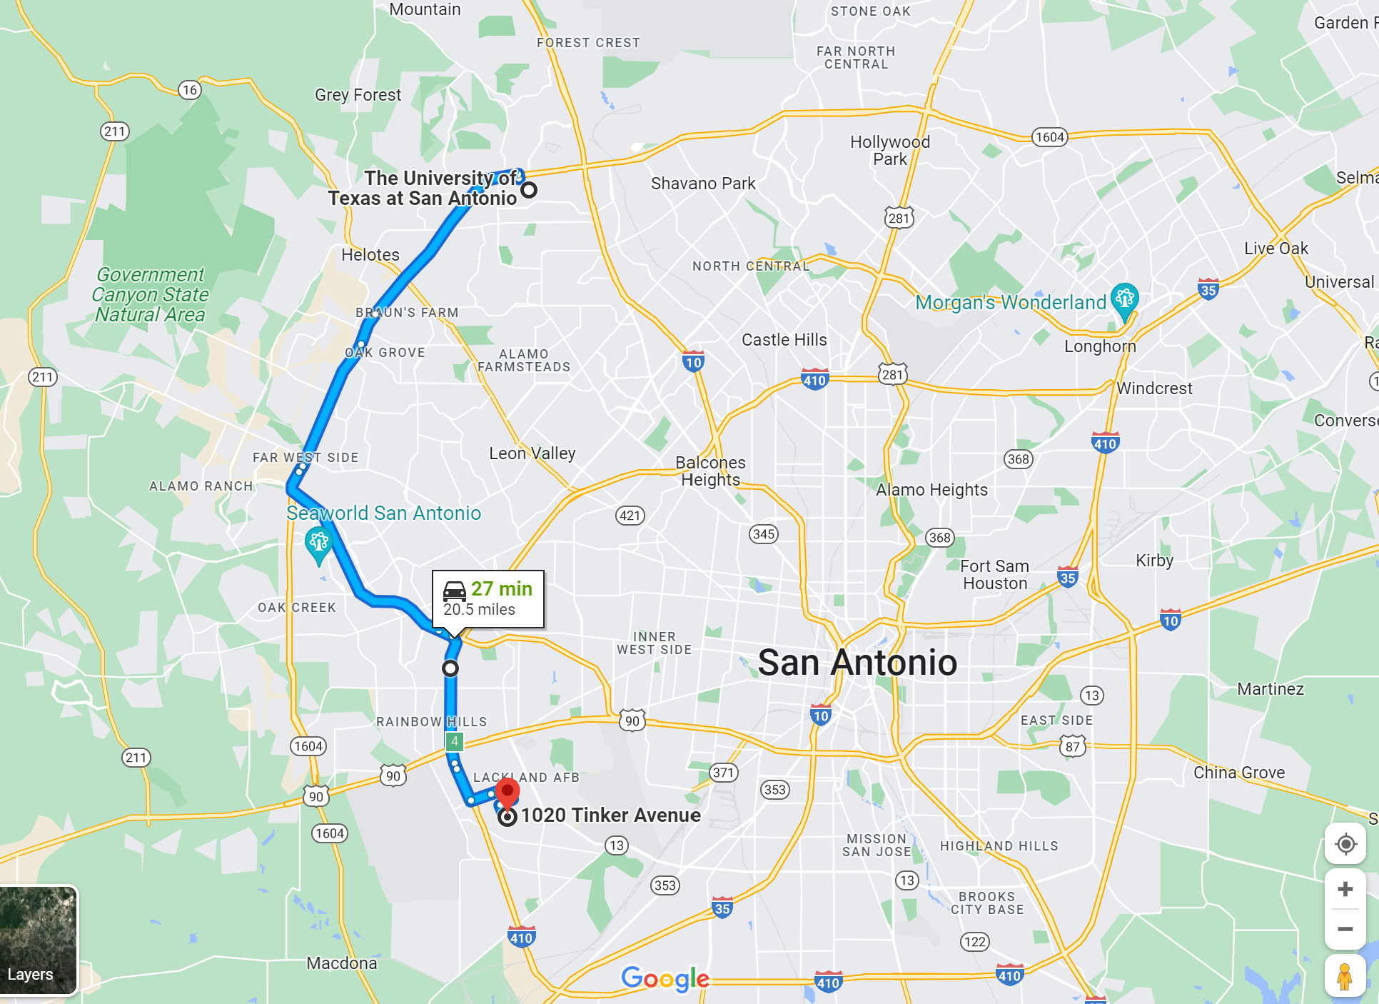
Venue Information
Air Force ROTC Detachment 842 • We Build Exceptional Officers • The University of Texas at San Antonio

Slide 10
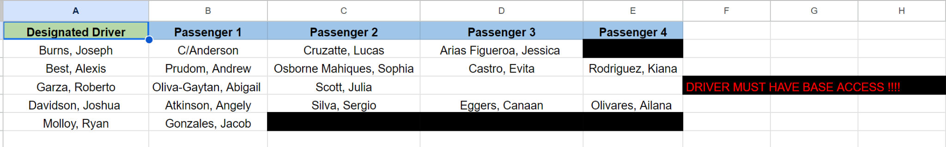
Venue Information
Air Force ROTC Detachment 842 • We Build Exceptional Officers • The University of Texas at San Antonio

Slide 11
Venue Information
1020 Tinker Ave
LACKLAND AFB
Air Force ROTC Detachment 842 • We Build Exceptional Officers • The University of Texas at San Antonio

Slide 12
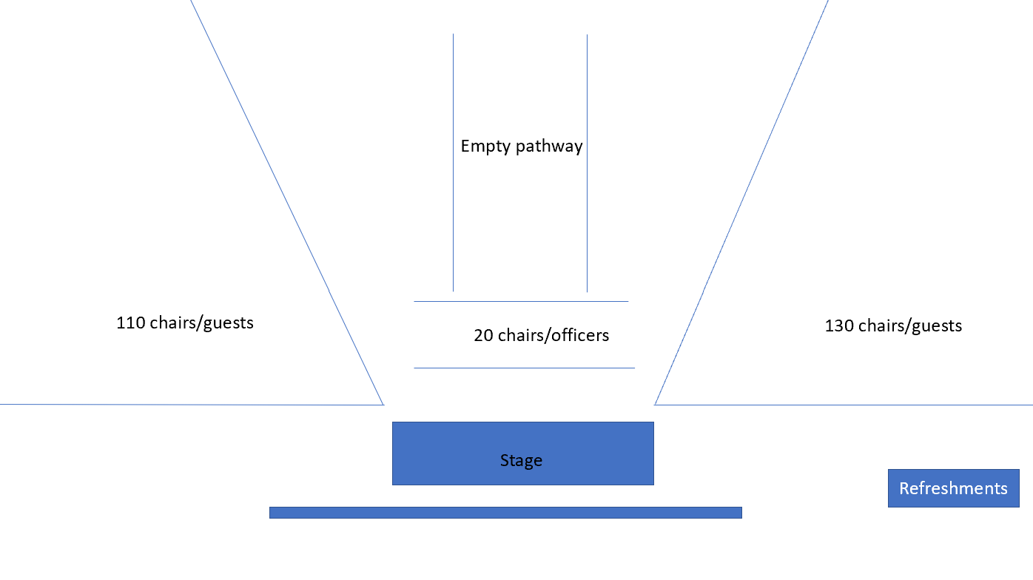
Venue Information
Air Force ROTC Detachment 842 • We Build Exceptional Officers • The University of Texas at San Antonio

Slide 13
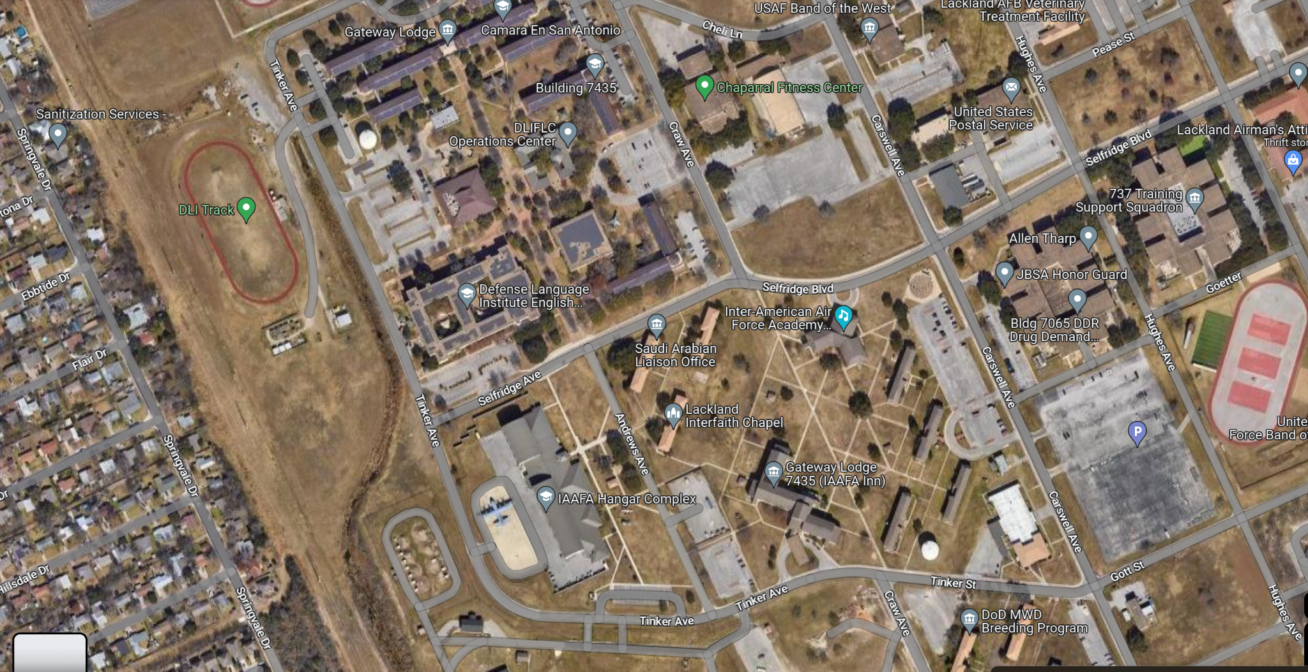
Venue Information
Air Force ROTC Detachment 842 • We Build Exceptional Officers • The University of Texas at San Antonio

Slide 14
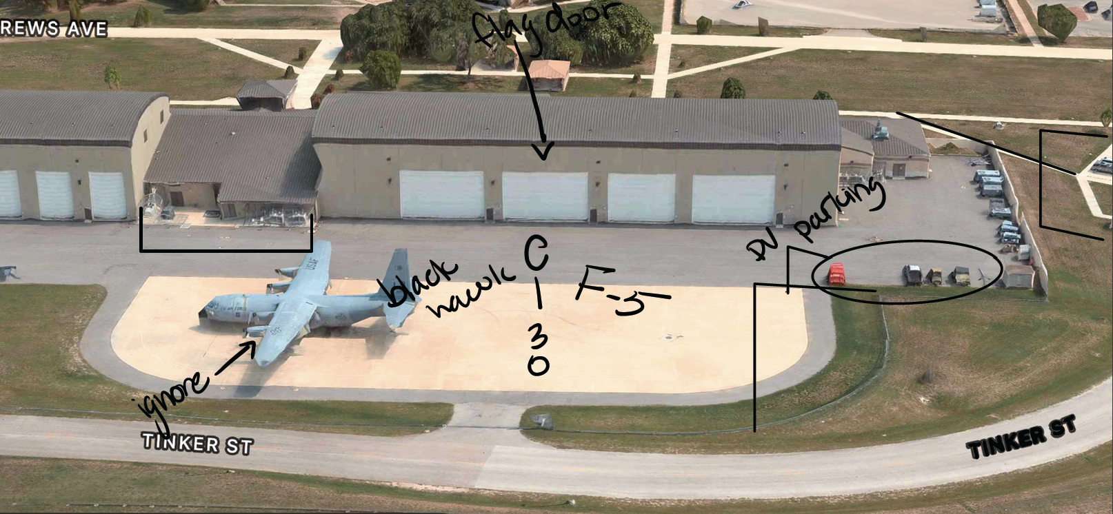
Venue Information
Air Force ROTC Detachment 842 • We Build Exceptional Officers • The University of Texas at San Antonio

Slide 15
Roles

Slide 16
Roles
LEADS
Rodriguez F, Finley
PA
Rodriguez F, Eggers, Burns
Usher Lead
Weaver
Guide Lead
Garza
Cake/Refreshments
Betzel, Atkinson, Silva
Chairs
Lead: Bendele, Cruzatte, Molloy
Air Force ROTC Detachment 842 • We Build Exceptional Officers • The University of Texas at San Antonio

Slide 17
Summary
Series of events
Venue Information
Save The Date
Script
Volunteers?
Air Force ROTC Detachment 842 • We Build Exceptional Officers • The University of Texas at San Antonio

Slide 18
Questions?

Slide 19
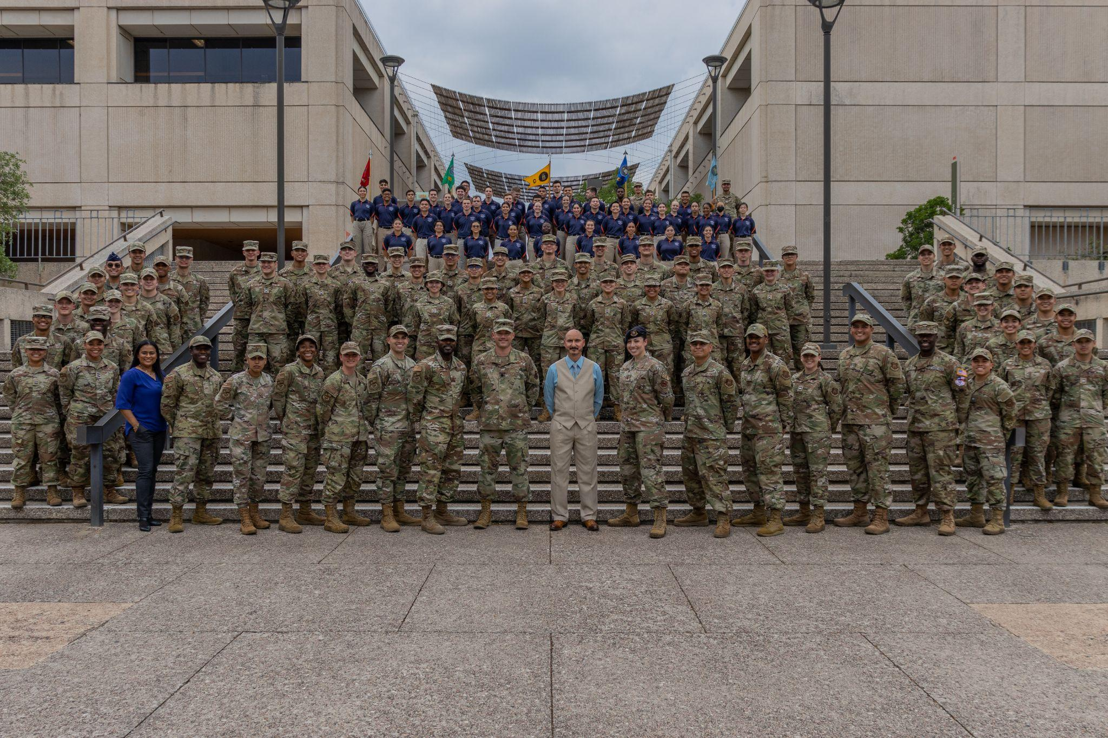
Air Force ROTC Detachment 842
The University of Texas at San Antonio
Det 842 – Best in Blue

